Slide 1
Controlling Robots with Open RAN Cellular Networks
JESSE – Summer 2026

Slide 2
Contact Information
Mentor:
Saurabh Parkar, sparkar@hawaii.edu
Professor:
Dr. Xiaochan Xue, xxue@hawaii.edu
Schedule:
M-W-F 9:00am – 3:00pm HH-488

Slide 3
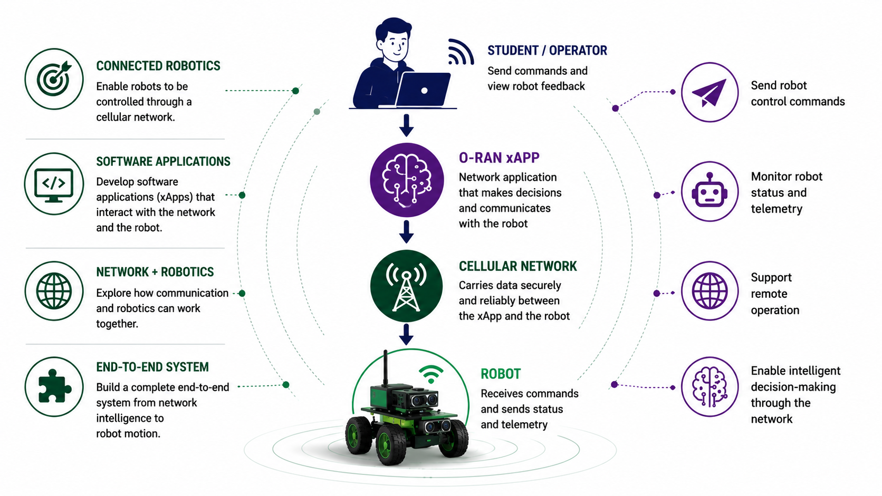
Project Overview

Slide 4
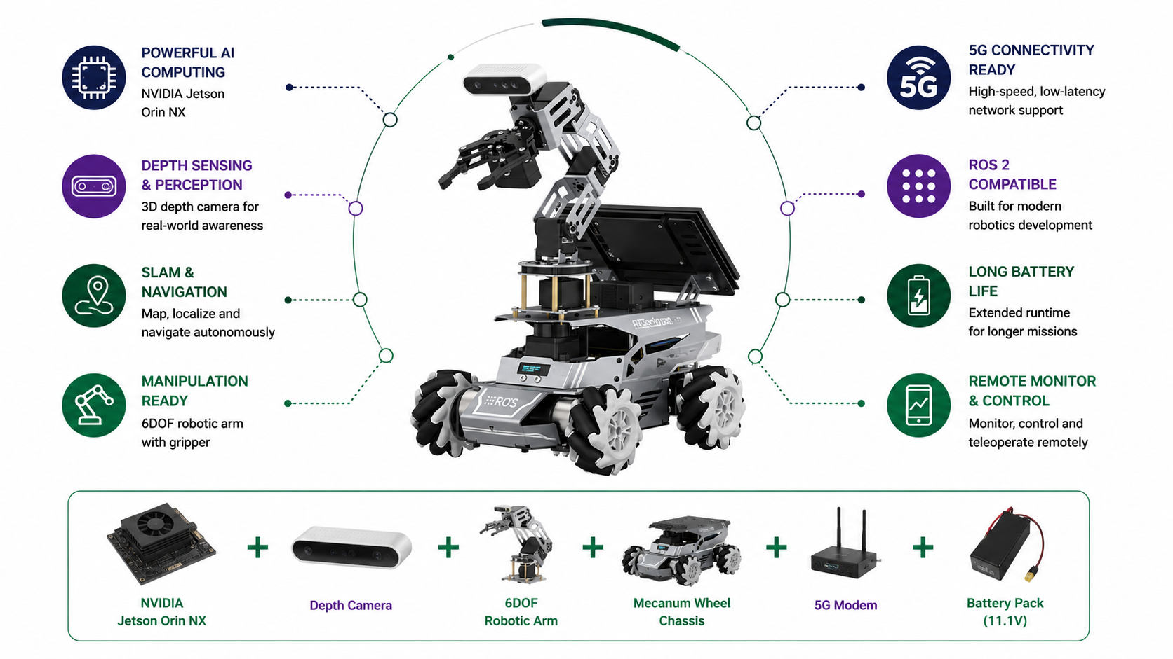
Robot Testbed

Slide 5
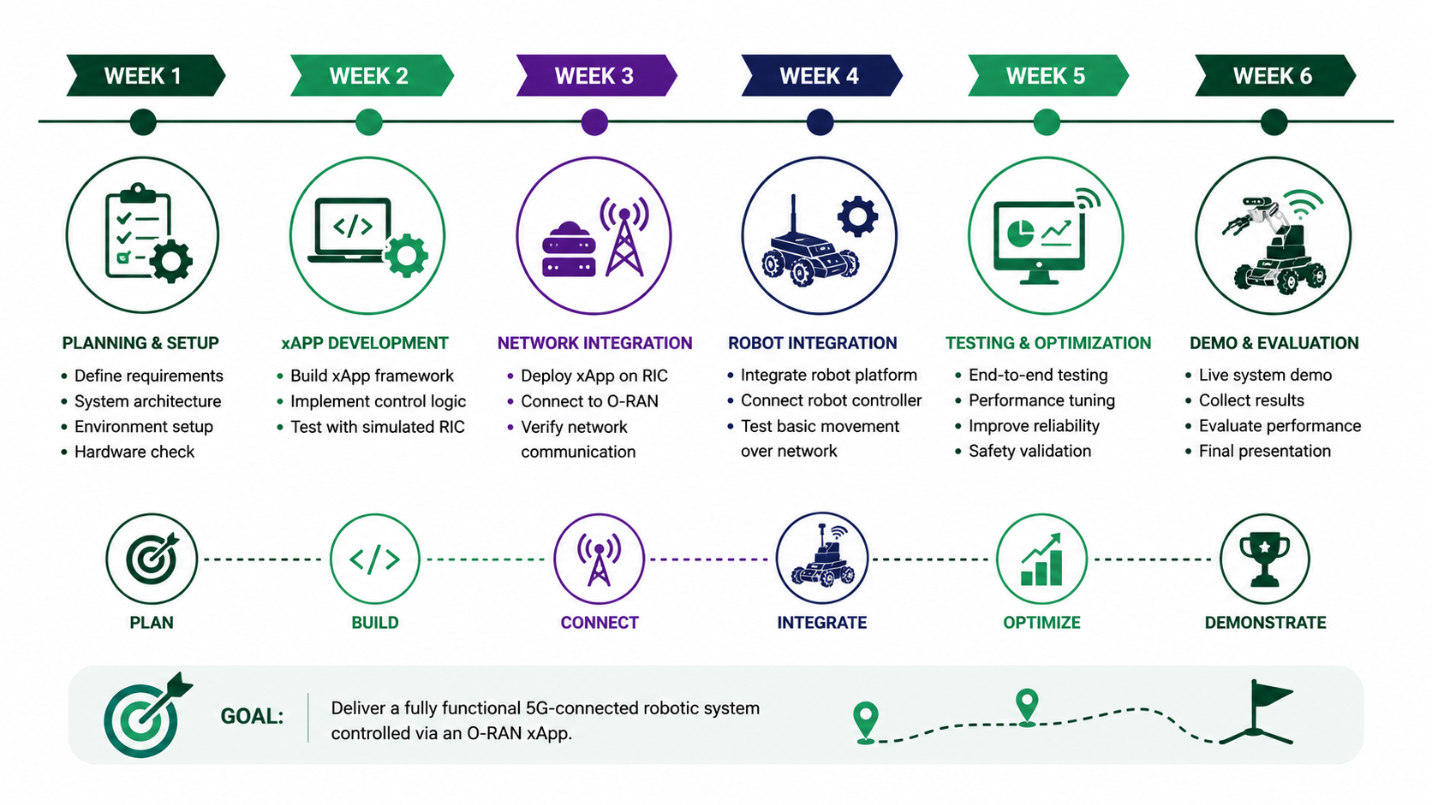
Project Roadmap

